Slide 1
Pokemon SV Nuzlocke Tool

Slide 2

Four States (Frames)
Route Name
Route Name
Route Name
Route Name
?
Pikachu
Pikachu
Pikachu
Roll Encounter
Successful Capture
Failed Capture
Unknown Encounter
Rolled Encounter
Successful Capture
Failed Capture

Slide 3
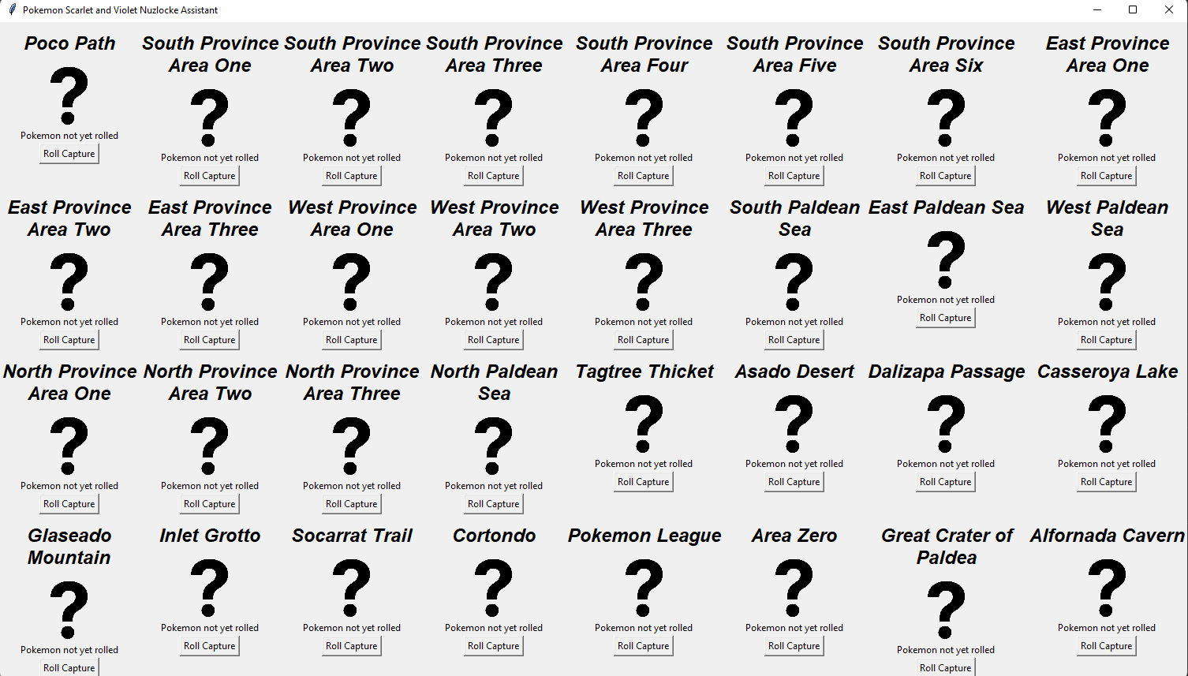
Scarlet
Violet
Save
Load
Current Level Cap:
Lv. 15

